Slide 1
Adrian Sim
Partner, Commercial Technology
Bristows LLP

Slide 2
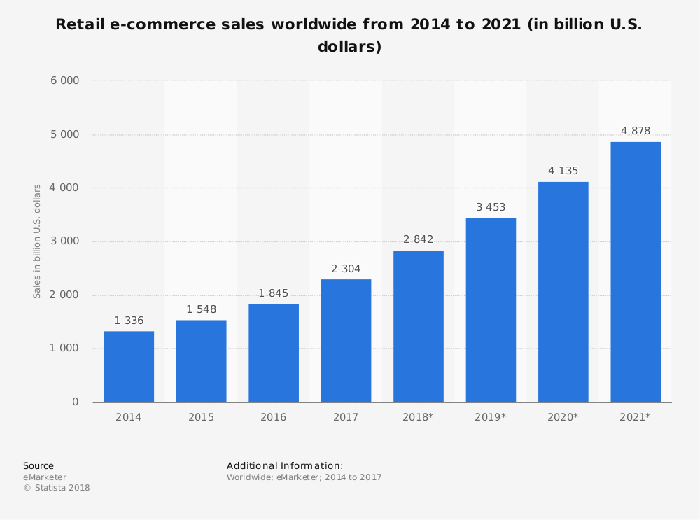
E-commerce and Digital Transformation
AGENDA
Regulatory changes – E-commerce in the DSM
Digital Transformation
Key commercial and legal issues in digital transformation deals

Slide 3
The E-commerce in the DSM – Recent Regulatory Developments
Unjustified Geo-Blocking Regulations (2018/302)
“Shop like a local” principle
Geo-blocking v Geo-discrimination
Major exclusions: services featuring copyright works (e.g. music streaming, e-books, software), financial services, audio-visual, transport, healthcare.
Practical impact and new business models?
Post-Brexit scenario
Online Portability Regulations (2017/1128)
Online content services contracted at home now accessible throughout the EU

Slide 4
The E-commerce in the DSM – Future regulatory changes
Directive for Contracts for Sale of Goods (2015/0288 (COD))
One set of rules for online and distance (but now also on-premises)
Directive for Contracts for Supply of Digital Content (2015/0287 (COD))
Also applies regardless of method of “sale” (noting applies to non-monetary consideration, e.g. personal data exchange).
Applies to both “sale” (perpetual licence) and digital content supplied under a limited licence.
Commission Proposal for Intermediation Services Regulation (2018/0112 (COD))
Regulating B2B “online intermediation services” which will include e-commerce platforms, search engines, app stores, social media for business, price comparison tools
Increased transparency, more effective dispute resolution, and enhanced monitoring
Role of the EU Observatory of the Online Platform Economy

Slide 5
Digital transformation of your E-commerce technology stack
“Back end stack”
Delivery tracking
CRM
API
SaaS
End user
POS
Payment Processing
CMS
PaaS
Security verification
ERP
IaaS

Slide 6
Digital transformation: Integration Risk
Biggest risk – integration
Technical – solution does not work
Financial – cost impact of doing the work
Contractual – who is liable / finger pointing
Who is bearing the contractual risk: client, prime / integrator, all suppliers?
More OLAs, Collaboration Agreements, Cooperation Schedules, Management Responsibilities
Dealing with cloud solutions
Legacy components
Cautionary tale – SAP v Diageo

Slide 7
Key Legal and Commercial Issues: Agile (customer’s view)
FEATURE | RISK | MITIGATION
Flexibility, shifting scope, scope creep | No certainty of cost (effective T&M?), lack of documentation, confusion over IP ownership | Set # of sprints, MVP
Collaborative working | Lack of warranties, finger-pointing, hard to prove breach | Focus on quality of personnel, obligations to manage, dependencies and relief
Early, usable functionality | Lack of customer discipline, Management of supplier / governance onerous | Strong governance procedures, advanced warning

Slide 8
Key Legal and Commercial Issues: When things go wrong
Incentive mechanisms
Liquidated Damages
Holdback / Retention
Customer Satisfaction Surveys
Reference Client
Liability
Unlimited liabilities – confidentiality? IPR infringement? Abandonment?
Deemed direct losses – costs payable to third party suppliers? Ex-gratia customer payments? Regulatory fines? Loss of profit?
Caps – 100%, 150%, 200%? Build, transition or run? Separate or super caps for property, data / security, personal data?
Cyber Insurance

Slide 9
Key Legal and Commercial Issues: GDPR
Re-negotiation or new provisions – different approach?
DP Indemnity
Reciprocal
Third party (data subject) claims v regulatory fines v all losses
Conduct of claim
Liability
Unlimited – still normal?
Super cap v separate cap
Cross-over with confidentiality and security clauses
Deemed direct losses

